Slide 1




DROWSINESS DETECTION
Submitted in the partial fulfilment for the award
of the degree of
Bachelor of Engineering
in
AIML
PRESENTED BY:- SUBMITTED TO:-
Ruchi Tiwari 22BAI70283 Mr. Sant Kumar Maurya
Nishu 22BAI70365 Assistant Professor
Vishu 22BAI70264

Slide 2



PROBLEM STATEMENT
In this advanced round, we call upon the first round winners and other top participants to develop an even more advanced technology that can swiftly and precisely detect driver drowsiness or unease. The aim remains the creation of a system that can be integrated into vehicles for a substantial enhancement in road safety.

Slide 3


SOLUTION APPROACH
Real-time Monitoring and Alert System: Integrating the algorithm into the in-car camera system to enable real-time monitoring of the driver's facial expressions and eye movement System.
Eye Tracking and Facial Expression Analysis: Analyze features such as drooping eyelids, changes in lip curvature, and overall facial muscle movements associated with drowsiness.
Real-time Driver Assistance and Intervention: This will alert the driver and provide proactive interventions to prevent potential accidents.

Slide 4

TECH STACK
OpenCV: It is a powerful open-source computer vision and machine learning software library that can be used for tasks such as image and video analysis.
TensorFlow: Libraries for building and training neural network models.
CNN: It can process video frames in real time, allowing for continuous monitoring of the driver's facial expressions and eye movements.

Slide 5




FLOWCHART
Drive Storage
Drive
Visuals
Data Set
User Defined Function
3
2
4
1
5

Slide 6





6
10
9
7
Face detection for yawn
8
Model Training
Cropping eye from jpg image
Eye detection for closed & open eye
Data Augmentation
Append both face and eye analysis in array
Preprocessing data array

Slide 7
Prediction calls
Accuracy and Error Analysis
Real time predictions
Save Model
Source: Web cam
13
12
14
11
15

Slide 8
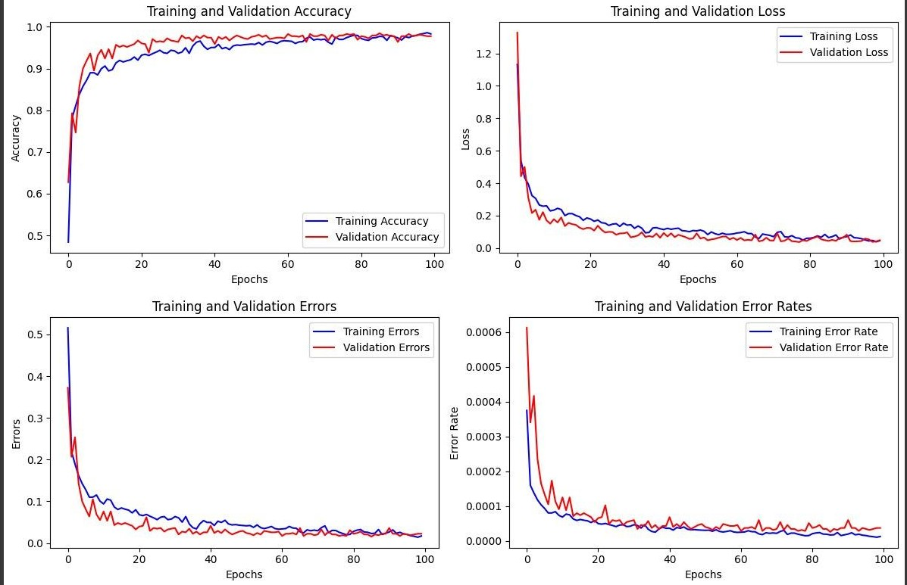
ANALYSIS
The model has higher accuracy and a lower loss rate.
The predictions made are pretty accurate with lower error rates.
The model is improving predictions over time.
It is converging to a solution.

Slide 9
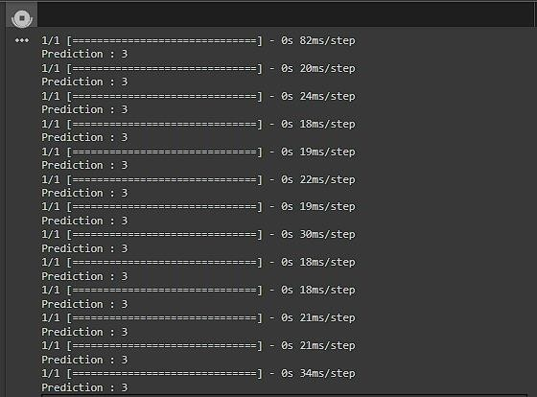
IMPLIMENTATION
Real Time analysis Source: Web cam

Slide 10



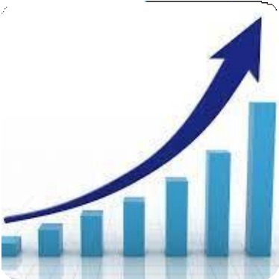




MARKET PROSPECT
Feasible
Scalable
Cost Efficient
Accuracy
Minimum Time

Slide 11



STATISTICS
Not related to drowsiness Drowsiness
40
30
20
10
0
Head on collision
Unintentional road exit
Intersection Accidents
Overtaking Accidents
Driven into from
behind
Collision with vehicle in front
Lane change Accidents
Hitting fixed
object

Slide 12


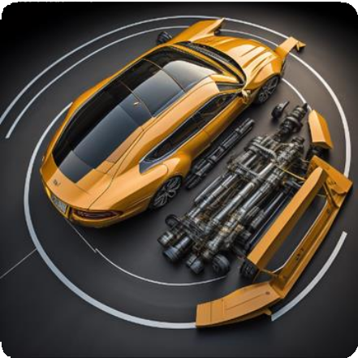
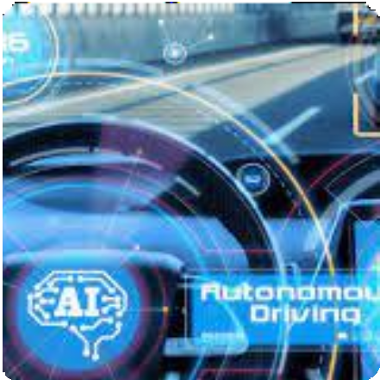
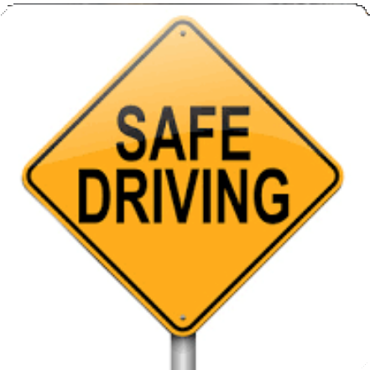
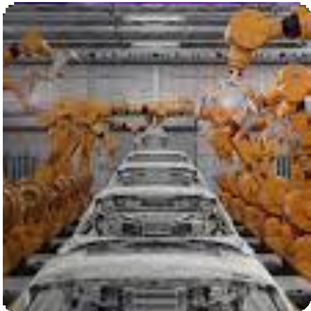
FUTURE SCOPE
Adaptive vehicle control
Integration with autonomous driving
Public safety and security
Sustainable manufacturing

Slide 13
THANK YOU

